Slide 1
KIIT UNIVERSITY
BHUBANESHWAR
Under the Guidance of
PROF. Chandani Kumari
Submitted by:
Nandini Kalita 1805675
Reedam Ranjan 1805686
Sourodeep Dhar 1805711
Sign Language
Translator

Slide 2
Introduction
SIGN LANGUAGE (SL)
Natural way of communication of speech and/or hearing-impaired people.
SIGN
Movement of one or both hands, accompanied with facial expression, which corresponds to a specific meaning.
TRANSLATOR
Communication between speech and/or sound impaired person and person that do not understand sign language, avoiding by this way the intervention of an intermediate person. And allow communication using their natural way of speaking.

Slide 3
Objective
To design the model and architecture for CNN to train the pre-processed images and achieve the maximum possible accuracy.
To develop an algorithm to predict the gesture in real-time.
To apply appropriate image pre-processing techniques.

Slide 4
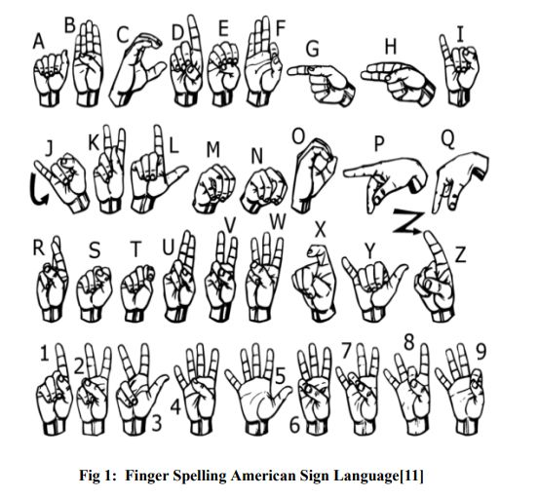
Contd..
In our project, we basically focus on producing a model which can recognize Fingerspelling-based hand gestures in order to form a complete word by combining each gesture. The gestures we aim to train are as shown in the side image.

Slide 5
Sign Language Translator
Let’s start with the set of slides

Slide 6
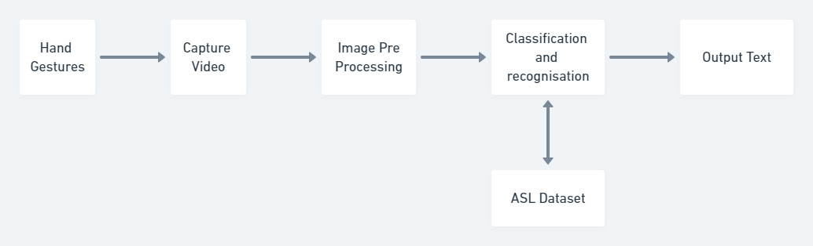
Data Flow Diagram

Slide 7
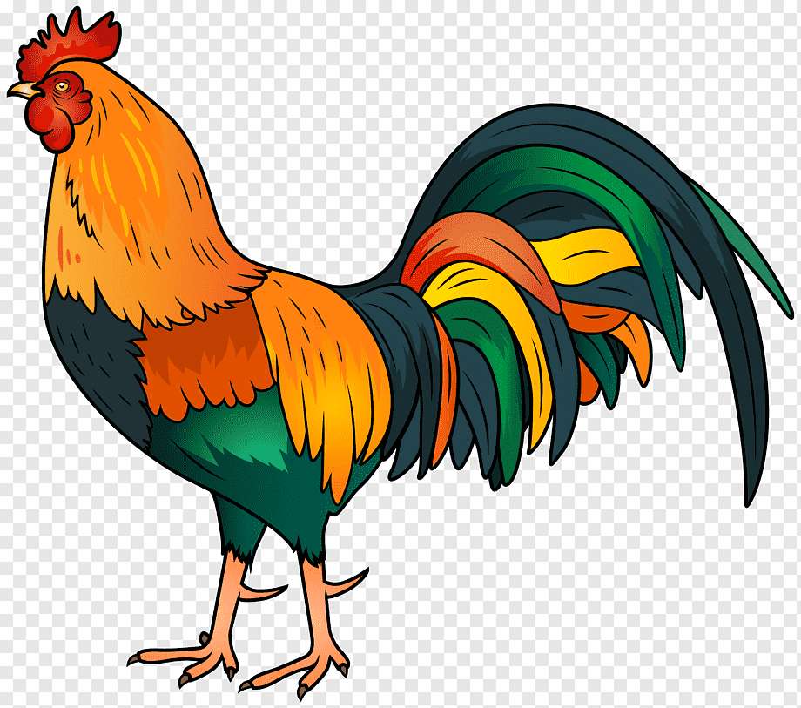
PREPARATION PHASE
Preprocess the data.
Specify and train the model.
Run a prediction using the model.

Slide 8

THE MOST IMPORTANT WORK
Define the Model.
Build the neural network.
Calculations and optimizations.

Slide 9

DELIGHT IS STILL DELAYED
EVALUATE THE NEURAL NETWORKS PERFORMANCE..
LINK THE WEBCAM.
NEURAL NETWORK ATTAINS A TRAIN ACCURACY OF 99.9% AND
A 97.4%VALIDATION ACCURACY.

Slide 10

SUCCESS IS DELAYED NOT DENIED
At this point, we have completed a sign language classifier. In essence, our model can correctly disambiguate between signs correctly almost all the time. This is a reasonably good model, so we move on to the final stage of our application. We will use this sign language classifier in a real-time webcam application.

Slide 11
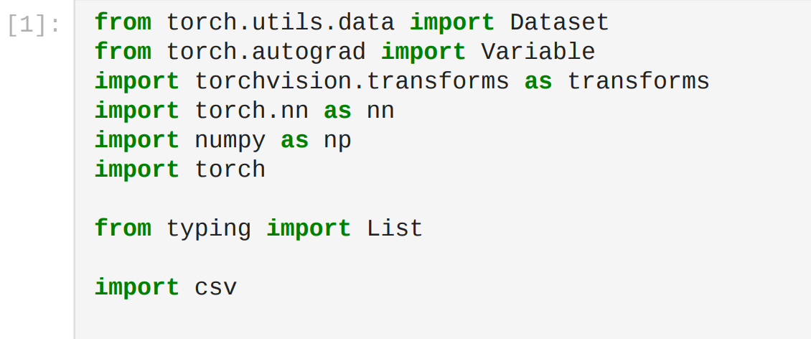
Importing Libraries

Slide 12
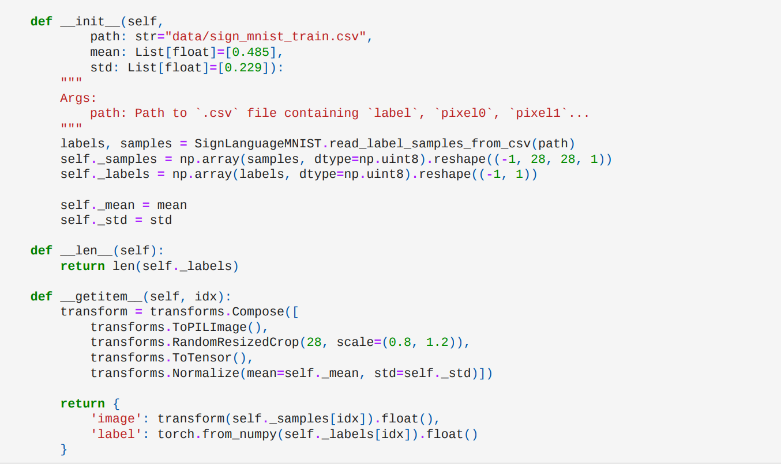
Preparing the Dataset Class

Slide 13
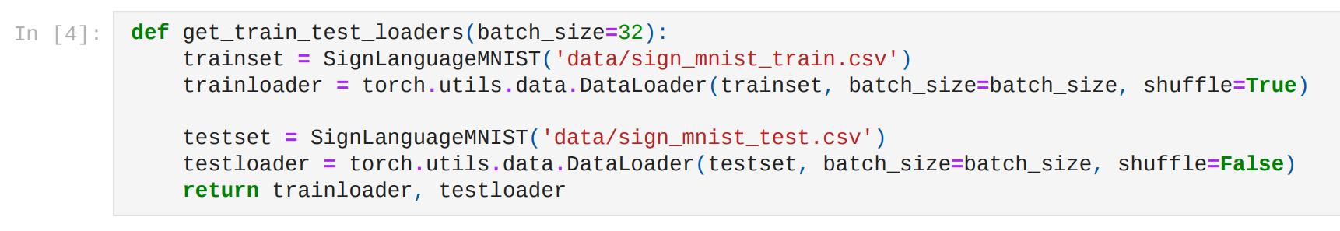
Dataset Split and Loading

Slide 14
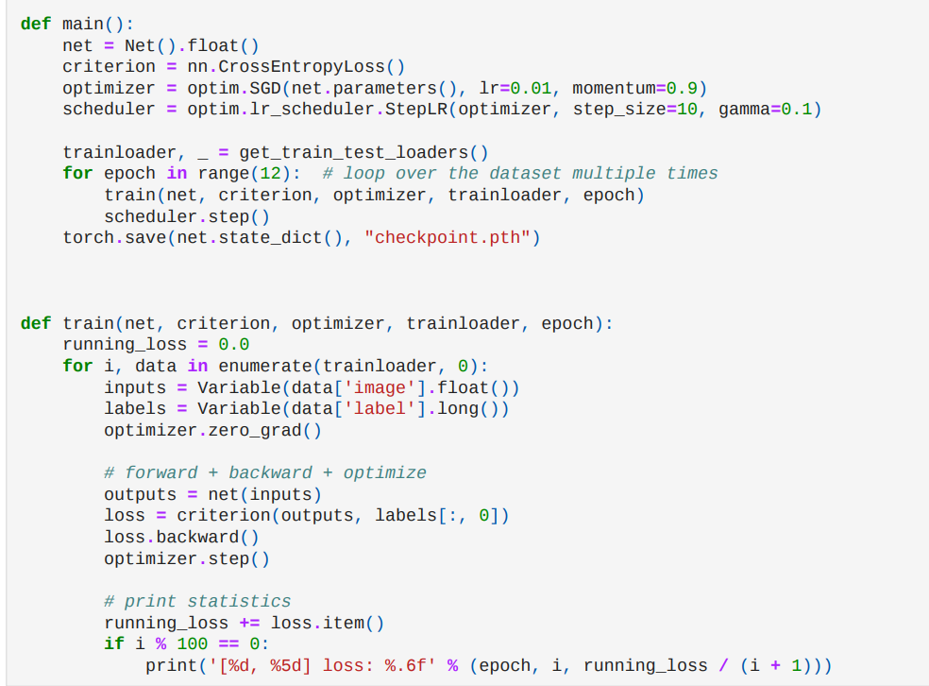
Building and Training

Slide 15
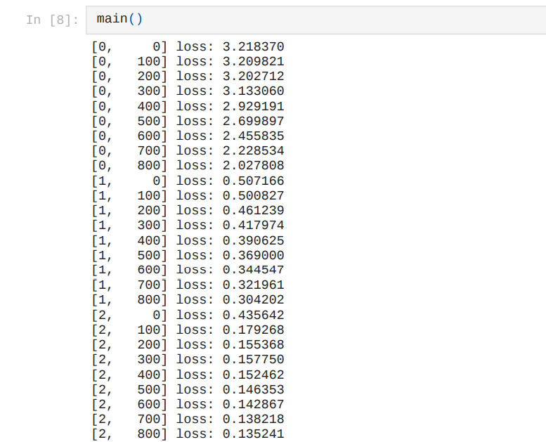
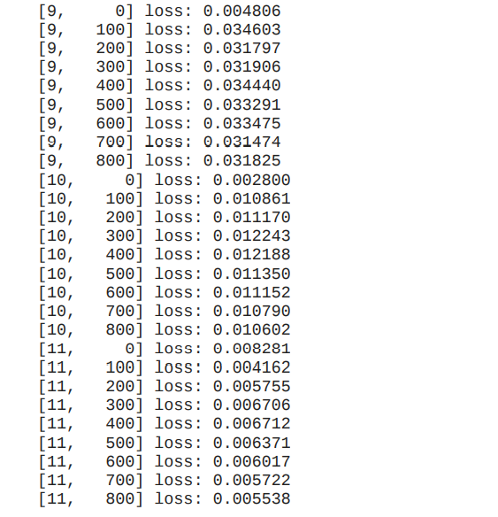
Training Set Output

Slide 16
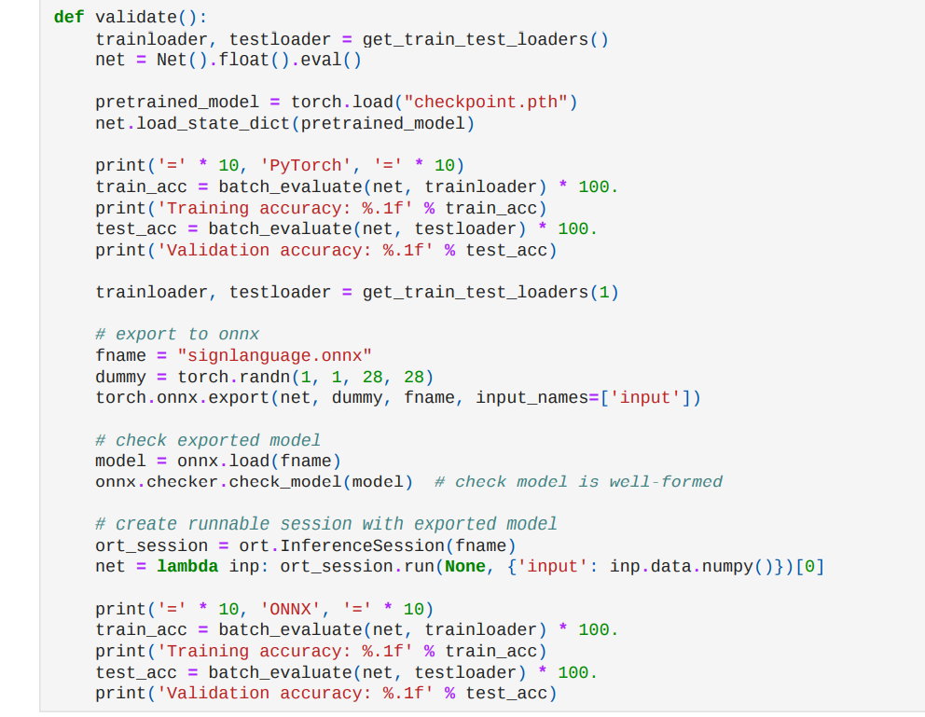
Validation

Slide 17
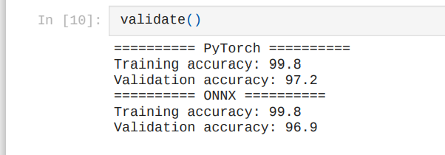
Validation Output

Slide 18
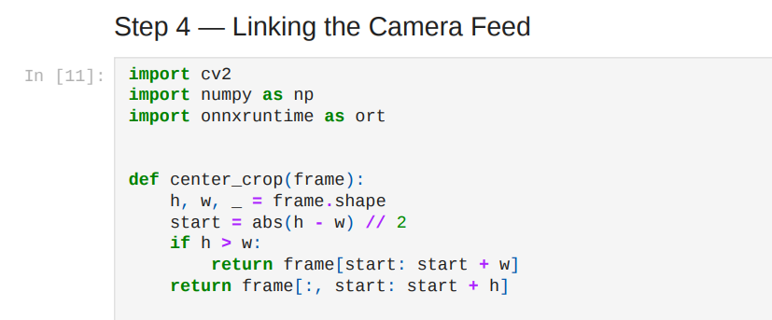
Linking the Camera Feed

Slide 19
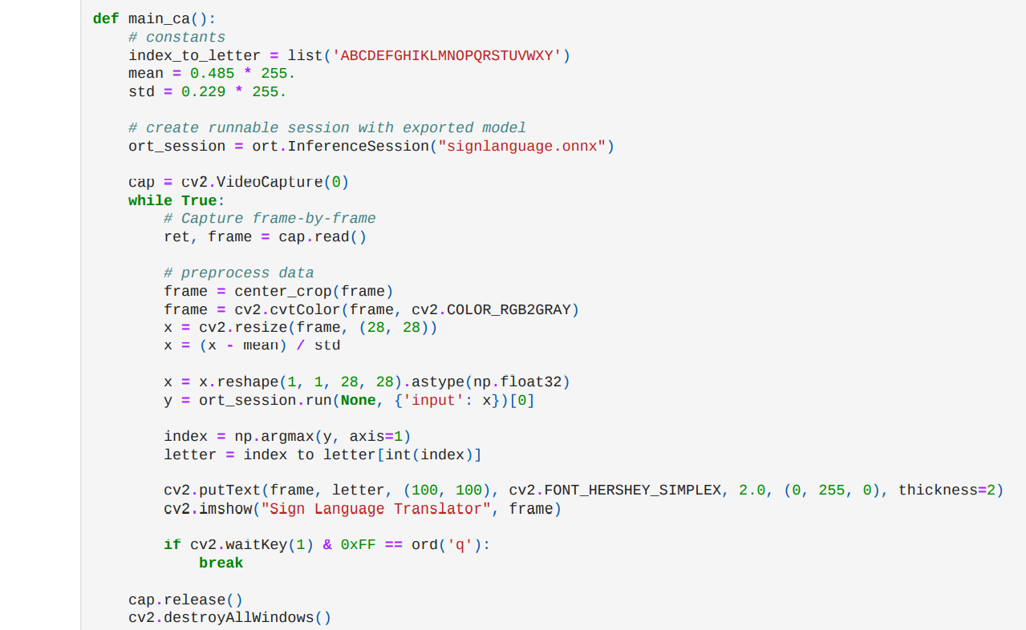
contd..

Slide 20
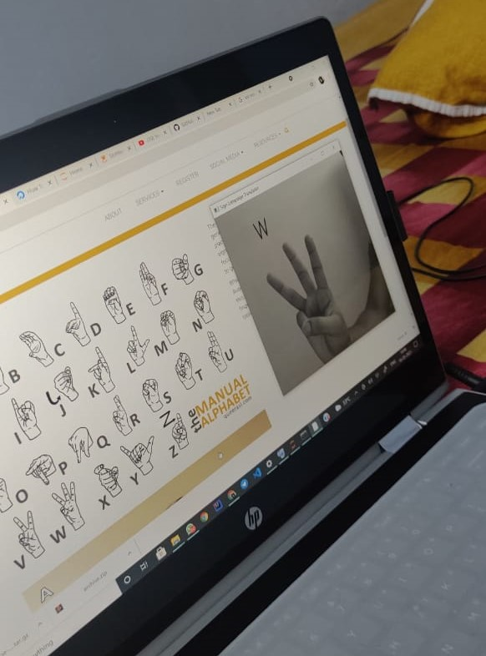
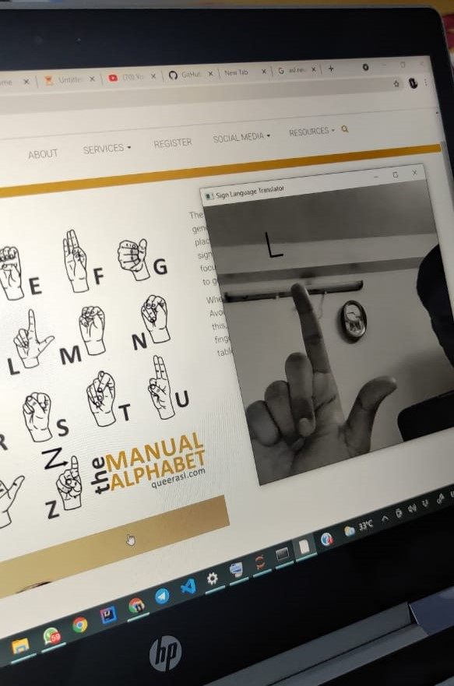
Output/Result

Slide 21
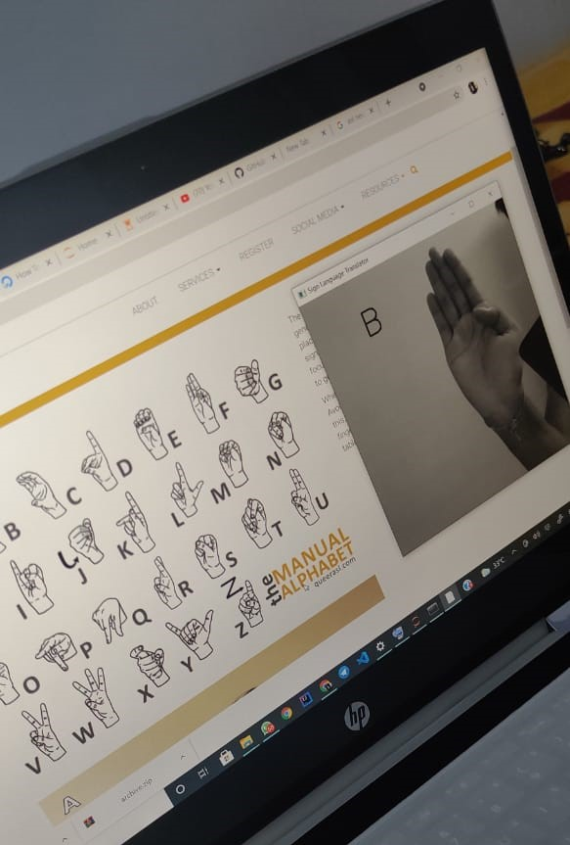
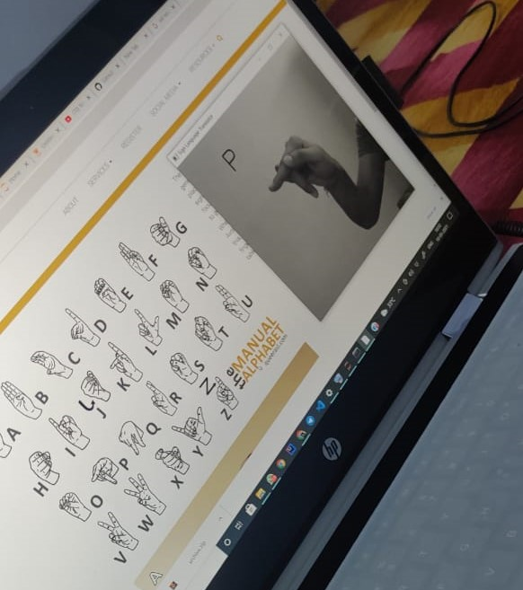
Output/Result

Slide 22
Advantages
Eliminates the need for an interpreter for communication between sign language and speech language.
Easy to incorporate and execute in any supporting operating system.
Real time translation.
Does not require any additional hardware.

Slide 23
Future Work
We can develop a complete product that will help the speech and hearing-impaired people, and thereby reduce the communication gap by planning to achieve higher accuracy even in case of complex backgrounds by trying out various background subtraction algorithms.

Slide 24
Challenges
Background subtraction for robust usage.
Making the system user independent.
Pattern matching training.

Slide 25
Conclusion
The feature vectors which include whole image frames containing all the aspects of the sign are considered.
The geometric features which are extracted from the signers' dominant hand, improve the accuracy of the system to a great degree.
There is no noise in the background and also see this application having real potential in improving the lives of the hearing-impaired and as such, it would be a worthy goal to continue development.

Slide 26
References(journals and web pages)
https://www.researchgate.net/publication/333585575_An_Efficient_Sign_Language_Translator_Device_Using_Convolutional_Neural_Network_and_Customized_ROI_Segmentation
http://cs231n.stanford.edu/reports/2016/pdfs/214_Report.pdf
https://ijarcce.com/wp-content/uploads/2020/06/IJARCCE.2020.9535.pdf

Slide 27
References
Pigou, Lionel, et al. ”Sign language recognition using convolutional neural networks.” Workshop at the European Conference on Computer Vision. Springer International Publishing, 2014.
2. Escalera, Sergio, et al. ”Chalearn looking at people challenge 2014: Dataset and results.” Workshop at the European Conference on Computer Vision. Springer International Publishing, 2014.
3. S. Hussain, R. Saxena, X. Han, J. A. Khan, and H. Shin, “Hand gesture recognition using deep learning”, 2017 International SoC Design Conference (ISOCC) , Seoul, pp. 1-6.

Slide 28
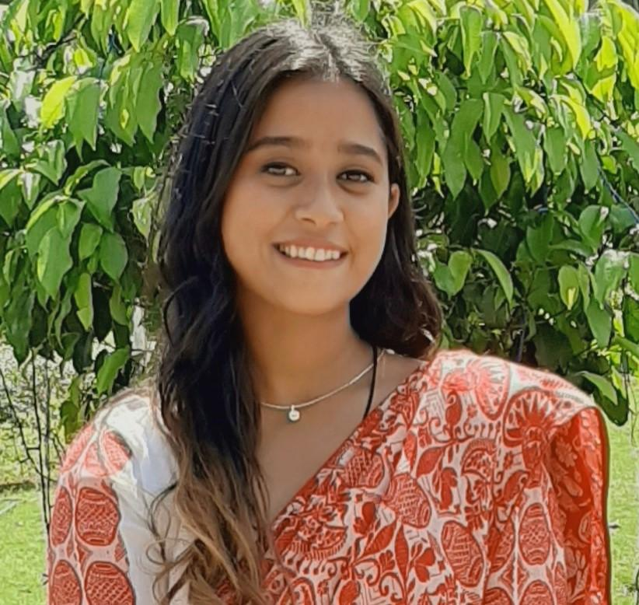
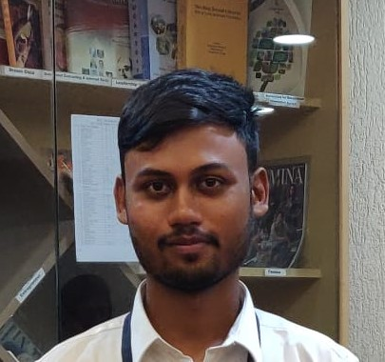

Team Presentation
Nandini Kalita
1805675
Reedam Ranjan
1805686
Sourodeep Dhar
1805711

